Slide 1
CSCI 1130 Introduction to Computing Using Java
Tutorial 7
1

Slide 2
Topics
Assignment 4 overview
String
Basic concepts and examples
API methods
Data conversion/ parsing
Exercises
2

Slide 3
Assignment 4: Music App

Slide 4
Music App
Aim:
1. practise file I/O and exception handling;
2. practise String processing.
Task: Create a Java application that transcripts a simple song score sheet.

Slide 5
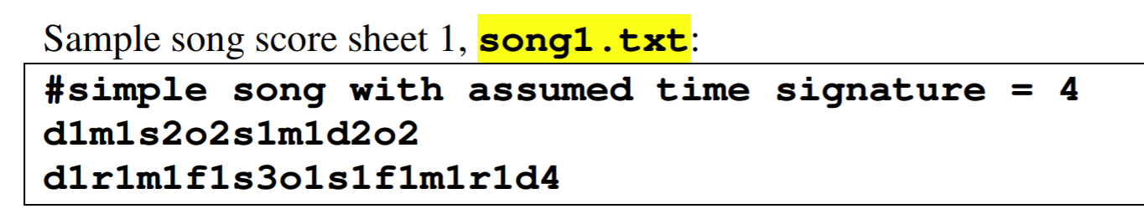
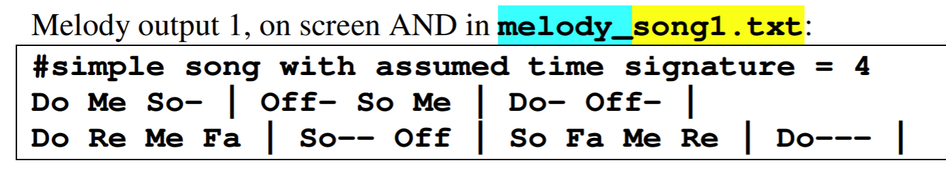
Requirement Example:
1. d, r, m, f, s, l, t and also o mean “Off” or rest;
2. digit integer denote the duration of the note in number of beats;
3. Sections are delimited by bars ‘|’;
4. A note lasting two or more beats are elongated with a display of dashes ‘-’.

Slide 6
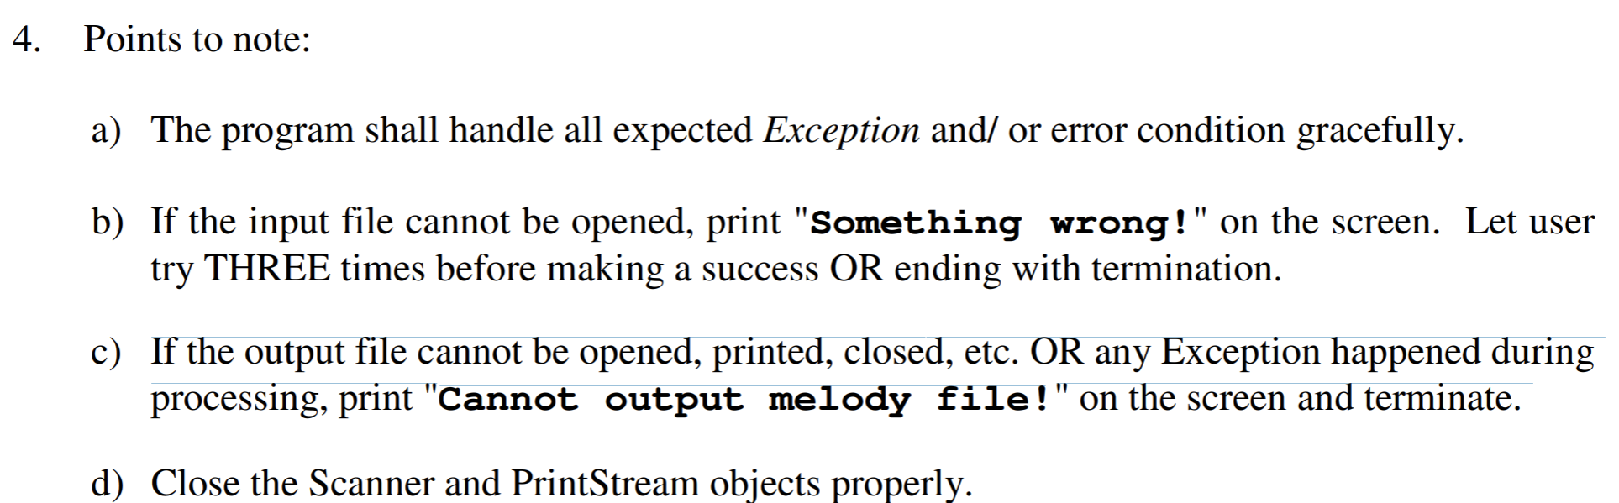
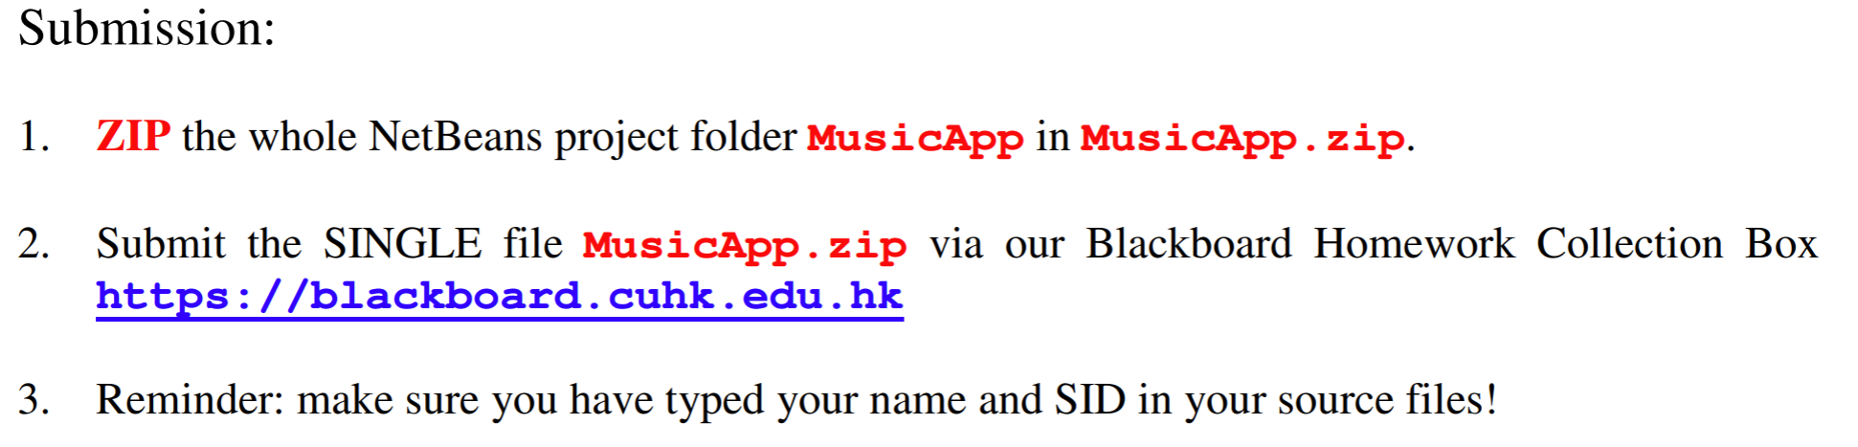
Procedure:
Work under a NetBeans Java Application project MusicApp. Name the package as musicapp.
Complete the program according to the above descriptions as well as the samples given.
Screen output of a complete sample run with text in blue indicates user keyboard input.

Slide 7
String basic idea and examples

Slide 8
String
The String class defines a convenient data type for storing and manipulating a sequence of characters, i.e. text.
Remember how to create an object?
<classname> <variable_or_field>;
<variable_or_field> = new <classname> ( );
Similarly, we can create a String object:
String myName;
myName = new String();

Slide 9
"No New?"
New-less String object creation!!!
String myName;
myName = "*** Michael Fung! Hi :)";
Yes, " " creates you a new String object with constant content.
This short-hand is dedicated to class String only!

Slide 10
String Properties
Strings are objects, not primitives!
int i = 999;
int j = i; // copy value of i (999) to j
String myName = "Michael Fung";
String yourName = myName; // copy object reference
yourName = "Microphone";
String
(object)
[Michael Fung]
String
(class)
myName

Slide 11
String Properties
Strings are objects, not primitives!
int i = 999;
int j = i; // copy value of i (999) to j
String myName = "Michael Fung";
String yourName = myName; // copy object reference
yourName = "Microphone";
String
(object)
[Michael Fung]
String
(class)
myName
yourName

Slide 12
String Properties
Strings are objects, not primitives!
int i = 999;
int j = i; // copy value of i (999) to j
String myName = "Michael Fung";
String yourName = myName; // copy object reference
yourName = "Microphone";
String
(object)
[Michael Fung]
String
(class)
myName
yourName
String
(object)
[Microphone]

Slide 13
String Properties
String objects can be concatenated (joined together) using a special operator ‘+’
String myName = "Michael Fung";
String yourName = "Microphone";
String concat = myName + " is...";
System.out.println(concat);
String hello = concat + yourName;
System.out.println(hello);
----------------------------------------
Michael Fung is...
Michael Fung is...Microphone
Class String is privileged to have the ‘+’.

Slide 14
String Properties
Content of a String object could be empty.
String myName;
myName = "";
String yourName;
null object reference ≠ String object ""
?
myName

Slide 15
String Properties
Content of a String object could be empty.
String myName;
myName = "";
String yourName;
null object reference ≠ String object ""
String
(object)
[ ]
String
(class)
myName

Slide 16
String Properties
Content of a String object could be empty.
String myName;
myName = "";
String yourName; // no assignment means null
null object reference ≠ String object ""
String
(object)
[ ]
String
(class)
myName
?
yourName

Slide 17
String Fields?!
If we glance through the Java Reference Manual or Java books, we seldom find the names of the fields defined in class String!
They are private and inaccessible by us.
They are encapsulated and well-protected.

Slide 18
String Methods
To manipulate a String object, we must use the provided methods.
Under clever and considerate design, the method names are self-explanatory.
To get the length of a String object,
String myName = "Michael Fung";
System.out.println(myName.length()); // message
Ooops… to get the length of an array,
int[ ] even_numbers = {2, 4, 6, 8, 10, 12, 14, 16};
System.out.println(even_numbers.length);// property

Slide 19
String Methods
Print a String vertically!
String myName = "Michael";
for (int i = 0; i < myName.length(); i++)
System.out.println(myName.charAt(i));
----------------------------------------------
M
i
c
h
a
e
l
The instance method char charAt(int) returns you a char at the i^{th} position of the String object.

Slide 20
String Methods
String
(class)
String
(object)
"…"
Compares 2 String objects.
Scanner keyboard = new Scanner(System.in);
String myName = "Michael";
String yourName = keyboard.nextLine();
if (myName == yourName)
System.out.println("Uk…Oh…");
else
System.out.println("What’s up?!");
------------------------------------
What’s up?!
We are comparing the references indeed!!!
String
(object)
"Michael"
==
?
myName
yourName

Slide 21
String Methods
String
(class)
String
(object)
"…"
Compares 2 String objects.
Scanner keyboard = new Scanner(System.in);
String myName = "Michael";
String yourName = keyboard.nextLine();
if (myName.equals(yourName))
System.out.println("Uk…Oh…");
else
System.out.println("What’s up?!");
------------------------------------
Uk…Oh…
We want to compare the contents.
String
(object)
"Michael"
==
?
myName
yourName

Slide 22
String API functions
String[] split(String regex, int limit)
// regex: a delimiting regular expression
// limit: the result threshold
limit > 0 : the pattern will be applied at most
limit-1 times;
limit < 0: the pattern will be applied as many times as
possible;
limit = 0: the pattern will be applied as many times as
possible, trailing empty strings will be discarded
https://www.geeksforgeeks.org/split-string-java-examples/

Slide 23
String API functions
Let the string to be splitted be :
geekss@for@geeks@
Regex Limit Result
@ 2 {“geekss”, “for@geeks@”}
@ 5 {“geekss”, “for”, “geekss”, “”}
@ -2 {“geekss”, “for”, “geekss”, “”}
@ 0 {“geekss”, “for”, “geekss”}
https://www.geeksforgeeks.org/split-string-java-examples/

Slide 24
String API functions
String[] split(String regex)
e.g. String s=“123,4,5,6,89”;
s.split(“,”)
-> [“123”, “4”, “5”, “6”, “89”];

Slide 25
String API functions
String[] split(String regex)
e.g. String s=“ABC|DEF|GHI”;
s.split(“|”)
-> [ “A”, “B”, “C”, “|”, “D”, “E”, “F”,
“|”, “G”, “H”, “I”];
| is interepreted as logical operator OR and Java regex engine splitted the String on empty String.
https://javarevisited.blogspot.com/2017/01/how-to-split-string-based-on-delimiter-in-java.html

Slide 26
String API functions
String[] split(String regex)
e.g. String s=“ABC|DEF|GHI”;
s.split(“\\|”)
-> [ “ABC”, “DEF”, “GHI”];
https://javarevisited.blogspot.com/2017/01/how-to-split-string-based-on-delimiter-in-java.html

Slide 27
String API functions
String[] split(String regex)
e.g. String s=“ABC|DEF|GHI”;
s.split(“[|]”)
-> [ “ABC”, “DEF”, “GHI”];
https://javarevisited.blogspot.com/2017/01/how-to-split-string-based-on-delimiter-in-java.html

Slide 28
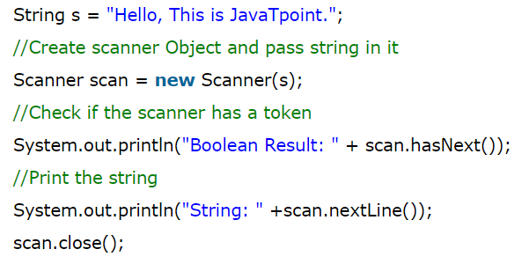

String API functions
Parse a String using Scanner
https://www.javatpoint.com/Scanner-class
Notes:
Scanner(String source). It constructs a new Scanner that produces values scanned from the specified string.

Slide 29
String API functions
String trim() //eliminates leading and trailing spaces.
e.g.
String s=“ hello word ”;
s.trim() -> “hello word”;

Slide 30
String API functions
Convert Int to String
- String a = "" + 123;
- String a = Integer.toString(123);
- String a = String.valueOf(123);

Slide 31
String API functions
Convert String to Int
int parseInt(String s)
e.g.
String s = “150”;
int number = Integer.parseInt(s);
-> number=150;

Slide 32
String API functions
Convert String to Double
double parseDouble(String s)
e.g.
String s = “3.14159”;
double number = Double.parseDouble(s);
-> number=3.14159;

Slide 33
String API functions
Convert Double to String
String valueOf(double d)
e.g.
double d = 11.01;
String s = String.valueOf(d);
-> s=“11.01”;

Slide 34
String API functions
String substring(int beginIndex, int endIndex)
String substring(int beginIndex)
char charAt(int index)
boolean endsWith(String suffix)
boolean startsWith(String prefix)
int indexOf(String str)
int length()

Slide 35
Exercise 1
Write a program that computes your initials from your full name and displays them.
e.g. Input: Michael Fung
Output: M.F.

Slide 36
Exercise 1 Solution
String myName = "Michael Fung";
String myInitials = "";
int length = myName.length();
for (int i = 0; i < length; i++) {
char c = myName.charAt(i);
if (c > 64 && c < 91) { // check if it is uppercase
myInitials += c + ".";
}
}
System.out.println("My initials are: " + myInitials);

Slide 37
Exercise 2
Write a program that replaces all ‘t’s with ‘l’s in a string where ‘t’ is not at the beginning or at the end of the string.
e.g. Input: toyhettowortdhat
Output: toyhelloworldhat

Slide 38
Exercise 2 Solution
String str = "toyhettowortdhat";
int len = str.length();
//get the substring of str from the start index of 1 and the //end index of (len-1), notice that (len-1) is exclusive
String substr = str.substring(1, len-1);
//replace all ‘t’s with ‘l’s
substr = substr.replace('t', 'l');
//concatenate the starting part, substring and the end part
str = str.substring(0,1) + substr + str.substring(len-1);
System.out.println(str);

Slide 39
Exercise 3
Write a program that firstly separates a name to several parts around the match of white space like ‘ ’, then converts the first letter of each part from lowercase to uppercase and finally outputs all parts.
e.g. Input: jackie smith
Output: Jackie
Smith

Slide 40
Exercise 3 Solution (w/ array)
String name = "jackie smith";
//seperate the name into several parts
String [] strArr = name.split(" ");
System.out.printf("There are totally %d parts "
+ "in this name:\n", strArr.length);
for (int i = 0; i < strArr.length; i++)
{
//convert the first letter of each part to uppercase
String part = strArr[i].substring(0, 1).toUpperCase()
+ strArr[i].substring(1);
System.out.println(part);
}

Slide 41
Exercise 4
Write a program that removes leading and trailing white spaces, and then finds the number of words, number of letters as well as the index of the third word in the resulting string, all without white space.
e.g. Input: " I,love,Java,a,lot "
Output: 5, 13, 7
i.e. Trim to "I,love,Java,a,lot"
→ 5 words, 13 letters, ‘J’ of ‘Java’ is at
index 7

Slide 42
Exercise 4 Solution
String str = " I,love,Java,a,lot ";
str = str.trim();
String [] words = str.split(",");
//the number of all words
System.out.printf("The total number of words is %d.\n", words.length);
//calculate the number of all letters
int letterSum = 0;
for (int i = 0; i < words.length; i++) {
int letterNum = words[i].length();
letterSum += letterNum;
}
System.out.printf("The total number of letters is %d.\n", letterSum);
//find the index of the third word in the string without white spaces
int indexOf3 = str.indexOf(words[2]);
System.out.printf("The index of the third word '%s' is %d.\n",
words[2], indexOf3);

